Slide 1
Exercise
In the bcmort data set, the four-level factor cohort can be considered the product of two two-level factors, say “period” (1981-1991 or 1991-2001) and “area” (Copenhagen/Fredriksberg and National). Generate those two factors.
Fit a Poisson regression model to the data with age, period, and area as descriptors, as well as the three two-factor interaction terms. The interaction between period and area can be interpreted as the effect of screening (explain why).

Slide 2
> library(ISwR)
> data(bcmort)
> summary(bcmort)
age cohort bc.deaths p.yr
50-54:4 Study gr. :6 Min. : 9.0 Min. : 25600
55-59:4 Nat.ctr. :6 1st Qu.: 51.0 1st Qu.: 86434
60-64:4 Hist.ctr. :6 Median :104.0 Median : 169261
65-69:4 Hist.nat.ctr.:6 Mean :213.2 Mean : 396520
70-74:4 3rd Qu.:436.2 3rd Qu.: 781897
75-79:4 Max. :545.0 Max. :1067778
> class(bcmort$cohort)
[1] "factor"
> dim(bcmort)
[1] 24 4
> bcmort$cohort
[1] Study gr. Study gr. Study gr. Study gr. Study gr. Study gr. Nat.ctr.
[8] Nat.ctr. Nat.ctr. Nat.ctr. Nat.ctr. Nat.ctr. Hist.ctr. Hist.ctr.
[15] Hist.ctr. Hist.ctr. Hist.ctr. Hist.ctr. Hist.nat.ctr. Hist.nat.ctr. Hist.nat.ctr.
[22] Hist.nat.ctr. Hist.nat.ctr. Hist.nat.ctr.
Levels: Study gr. Nat.ctr. Hist.ctr. Hist.nat.ctr.
> area <- factor(gl(2,6,24,c("Local","National")))
> period <- factor(gl(2,12,24,c("1990s","1980s")))

Slide 3
> data.frame(bcmort$cohort,area,period)
bcmort.cohort area period
1 Study gr. Local 1990s
2 Study gr. Local 1990s
3 Study gr. Local 1990s
4 Study gr. Local 1990s
5 Study gr. Local 1990s
6 Study gr. Local 1990s
7 Nat.ctr. National 1990s
8 Nat.ctr. National 1990s
9 Nat.ctr. National 1990s
10 Nat.ctr. National 1990s
11 Nat.ctr. National 1990s
12 Nat.ctr. National 1990s
13 Hist.ctr. Local 1980s
14 Hist.ctr. Local 1980s
15 Hist.ctr. Local 1980s
16 Hist.ctr. Local 1980s
17 Hist.ctr. Local 1980s
18 Hist.ctr. Local 1980s
19 Hist.nat.ctr. National 1980s
20 Hist.nat.ctr. National 1980s
21 Hist.nat.ctr. National 1980s
22 Hist.nat.ctr. National 1980s
23 Hist.nat.ctr. National 1980s
24 Hist.nat.ctr. National 1980s

Slide 4
> drop1(glm(bc.deaths ~ age+period+area+age:period+age:area+period:area+offset(log(p.yr))
,family=poisson),test="Chisq")
Single term deletions
Model:
bc.deaths ~ age + period + area + age:period + age:area + period:area +
offset(log(p.yr))
Df Deviance AIC LRT Pr(Chi)
<none> 5.458 202.405
age:period 5 34.792 221.739 29.334 1.994e-05 ***
age:area 5 17.279 204.226 11.821 0.0373179 *
period:area 1 16.775 211.722 11.317 0.0007678 ***
---
Signif. codes: 0 ‘***’ 0.001 ‘**’ 0.01 ‘*’ 0.05 ‘.’ 0.1 ‘ ’ 1

Slide 5
> summary(glm(bc.deaths ~
age+period+area+age:period+age:area+period:area+offset(log(p.yr)),
family=poisson),test="Chisq")
Coefficients:
Estimate Std. Error z value Pr(>|z|)
(Intercept) -8.71065 0.20674 -42.133 < 2e-16 ***
age55-59 0.59227 0.23373 2.534 0.011277 *
age60-64 1.08881 0.22321 4.878 1.07e-06 ***
age65-69 1.24619 0.21945 5.679 1.36e-08 ***
age70-74 1.62200 0.21709 7.472 7.93e-14 ***
age75-79 1.93431 0.23583 8.202 2.36e-16 ***
period1980s 0.76507 0.15539 4.924 8.50e-07 ***
areaNational -0.36892 0.20220 -1.825 0.068070 .
age55-59:period1980s -0.34415 0.14996 -2.295 0.021735 *
age60-64:period1980s -0.55380 0.14786 -3.746 0.000180 ***
age65-69:period1980s -0.58432 0.14731 -3.967 7.29e-05 ***
age70-74:period1980s -0.65739 0.14776 -4.449 8.62e-06 ***
age75-79:period1980s -0.56839 0.16360 -3.474 0.000512 ***
age55-59:areaNational 0.69382 0.22708 3.055 0.002248 **
age60-64:areaNational 0.52311 0.21633 2.418 0.015600 *
age65-69:areaNational 0.49641 0.21251 2.336 0.019492 *
age70-74:areaNational 0.38044 0.21047 1.808 0.070675 .
age75-79:areaNational 0.33547 0.22865 1.467 0.142325
period1980s:areaNational -0.29262 0.08796 -3.327 0.000879 ***
> tapply(bc.deaths/p.yr,list(area,period),mean)*100000
1990s 1980s
Local 57.42036 74.18913
National 61.76304 57.55497

Slide 6
Exercise 2
Use the elastic net to develop predictors for AD vs. NDC.
Try repeated cross-validation runs and compare the plots.
What happens if we use α = 0.3 or 0.7 instead of 0.5?
Why would we run into difficulties if we used cross-validated logistic regression?
Repeat the analysis for AD vs. OD.

Slide 7
> library(glmnet)
> dim(ad.data)
[1] 104 125
> diagnosis <- ad.data[,1]
> summary(diagnosis)
AD NDC OD
33 30 41
> isub <- diagnosis != "NDC"
> admat.net <- as.matrix(ad.data[isub,-1])
> diag.net <- droplevels(diagnosis[isub])
> summary(diag.net)
AD OD
33 41
> ad.cv <- cv.glmnet(admat.net,diag.net,family="binomial")
> lmin <- ad.cv$lambda.min
> l1se <- ad.cv$lambda.1se
> lmin
[1] 0.01028176
> l1se
[1] 0.0630879

Slide 8
> ad.net <- glmnet(admat.net,diag.net,family="binomial")
> predict(ad.net,s=lmin,type="nonzero")
X1
1 1
2 8
3 10
4 12
5 20
6 22
……………
25 113
26 117
27 118
> predict(ad.net,s=l1se,type="nonzero")
X1
1 1
2 10
3 12
4 17
5 28
6 32
7 69
8 78
9 93
10 110
11 120

Slide 9
> colnames(admat.net)[predict(ad.net,s=l1se,type="nonzero")$X1]
[1] "ACE..CD143." "ApoAI" "ApoB"
[4] "Apolipoprotein.A1" "Calcitonin" "CD40.Ligand"
[7] "IGF.1" "IL.18" "MIF"
[10] "Prostate.Specific.Antigen..Free" "Stem.Cell.Factor"
> plot(cv.glmnet(admat.net,diag.net,family="binomial",type="class"))
> plot(cv.glmnet(admat.net,diag.net,family="binomial"))

Slide 10
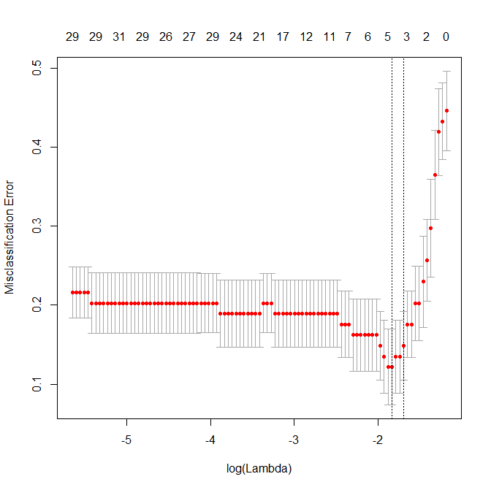

Slide 11
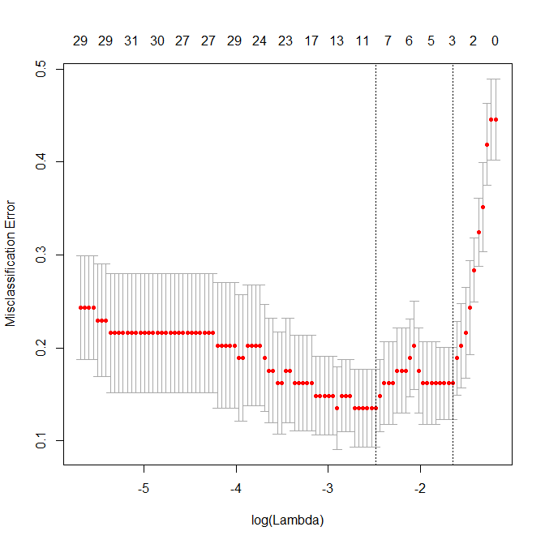

Slide 12
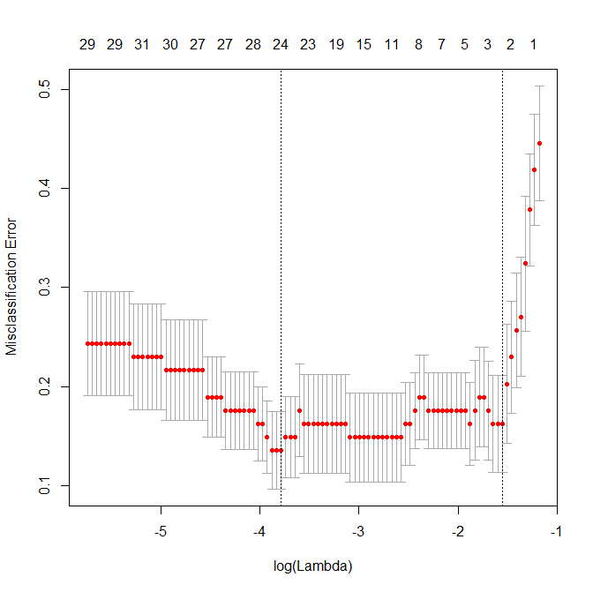

Slide 13
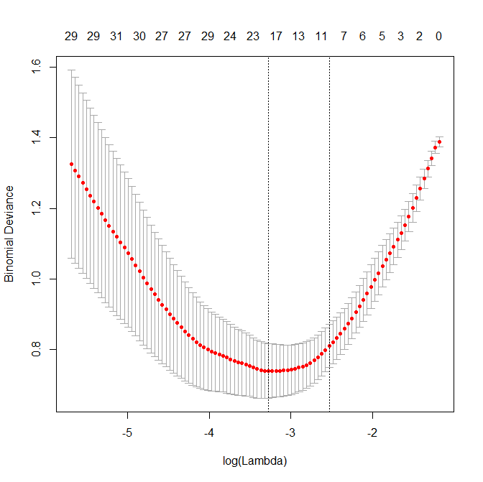

Slide 14
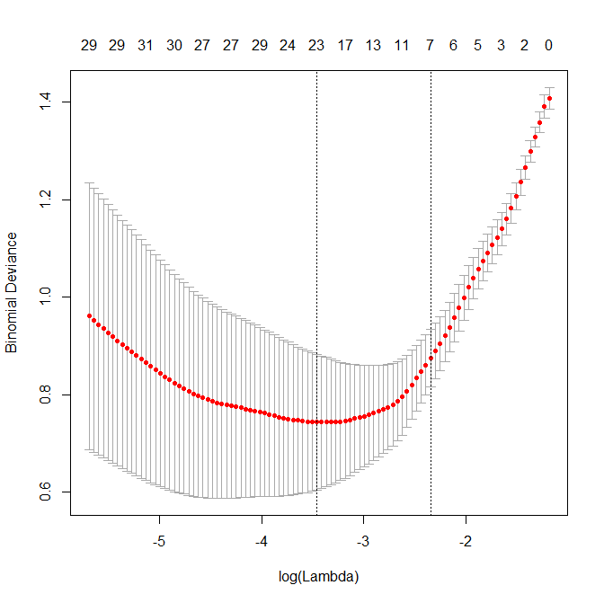

Slide 15
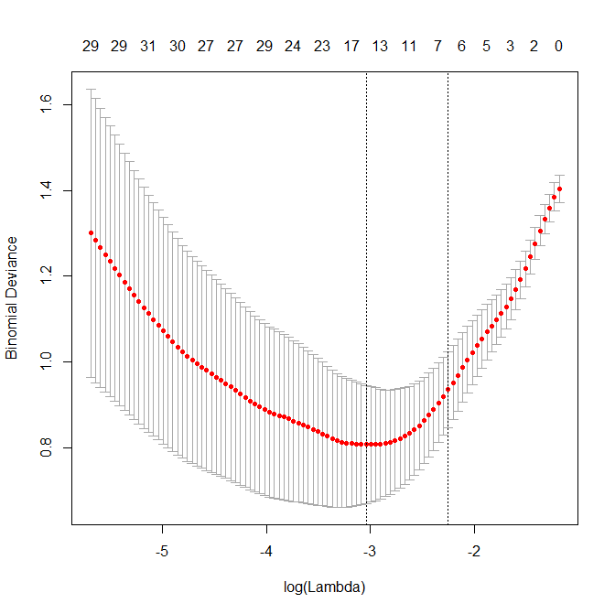

Slide 16
> predict(ad.net.5,s=l1se,type="nonzero")
X1
1 1
2 4
3 8
4 10
5 12
…………
30 113
31 117
32 118
33 120
> colnames(admat.net)[predict(ad.net.5,s=l1se,type="nonzero")$X1]
[1] "ACE..CD143." "Agouti.Related.Protein..AgRP."
[3] "Angiopoietin.2..ANG.2." "ApoAI"
[5] "ApoB" "ApoE"
[7] "ApoH" "Apolipoprotein.A1"
[9] "Apolipoprotein.CIII" "ASP"
[11] "B.Lymphocyte.Chemoattractant..BLC." "Betacellulin"
[13] "Calcitonin" "CD40.Ligand"
[15] "Cortisol" "Creatine.Kinase.MB"
[17] "EGF.R" "Ferritin"
[19] "FSH" "HCC.4"
[21] "IGF.1" "IL.13"
[23] "IL.18" "MCP.3"
[25] "MDC" "MIF"
[27] "MIP.1.alpha" "Prostate.Specific.Antigen..Free"
[29] "Pulmonary.and.Activation.Regulated.Chemokine..PARC." "PYY"
[31] "SGOT" "SHBG"
[33] "Stem.Cell.Factor"

Slide 17
> plot(cv.glmnet(admat.net,diag.net,family="binomial",type="class",alpha=0.5))
> preds.5 <- predict(ad.net.5,s=l1se,newx=admat.net,type="class")
> table(preds.5,diag.net)
diag.net
preds AD OD
AD 31 0
OD 2 41
> preds <- predict(ad.net,s=l1se,newx=admat.net,type="class")
> table(preds,diag.net)
diag.net
preds AD OD
AD 30 0
OD 3 41
Plots show minimum cross-validated error is between 10% and 20%.
If we predict to the whole data set using a model fitted from the
whole data set, the apparent error is under 5%. The former estimate
is the more realistic. Even better would be to do nested CV.
If we predict at lambda = lmin, the apparent error rate is near 0.

Slide 18
